Slide 1
NEURAL NETWORKS

Slide 2
LEARNING OBJECTIVES
PROGRESSING IN YOUR DATA SCIENCE CAREER
Understand various types of neural networks
Applications of neural networks
Apply a neural network model for regression
Apply a neural network model for classification

Slide 3
COURSE
PRE-WORK

Slide 4
PRE-WORK REVIEW
Understand Logistic Regression and link functions
Be familiar with training and testing classifiers and regressors

Slide 5
OPENING
ARTIFICIAL NEURAL NETWORKS

Slide 6
OPENING
Neural networks were first studied in the 1940s (!) as a model of biological neural networks
Many advances since then have improved the ability to train and apply neural networks
Good for both classification and regression but difficult to interpret model behaviors
Deep learning in the past few years has been highly successful for otherwise difficult problems

Slide 7
OPENING
Today we will focus on types of neural networks and their applications, and skip some of the more technical details
Specifically we’ll skip training neural networks -- there are many methods in various situations and the details can be tedious (but not particularly difficult)
Methods include backpropagation, gradient descent, and Hessian-free learning

Slide 8
INTRODUCTION
PERCEPTRON

Slide 9
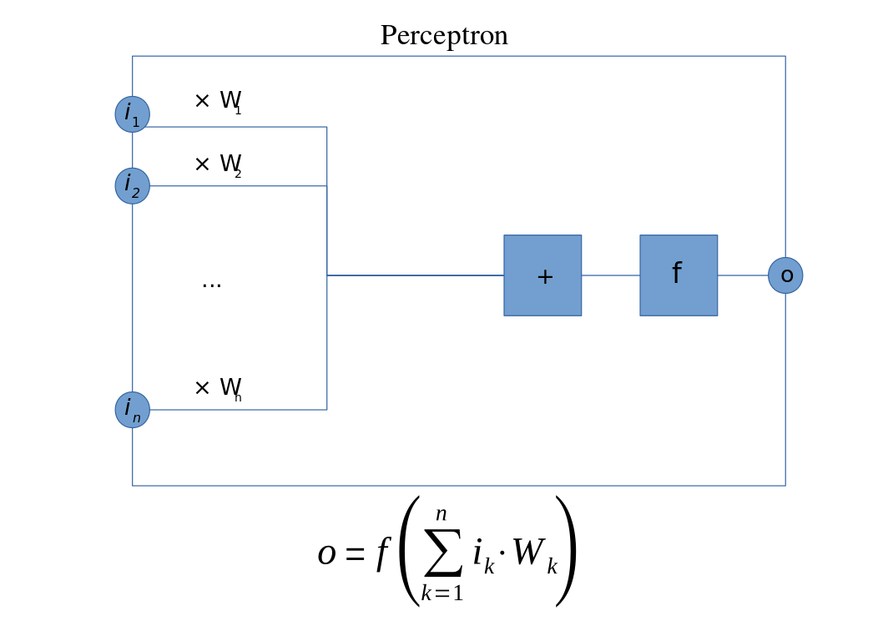
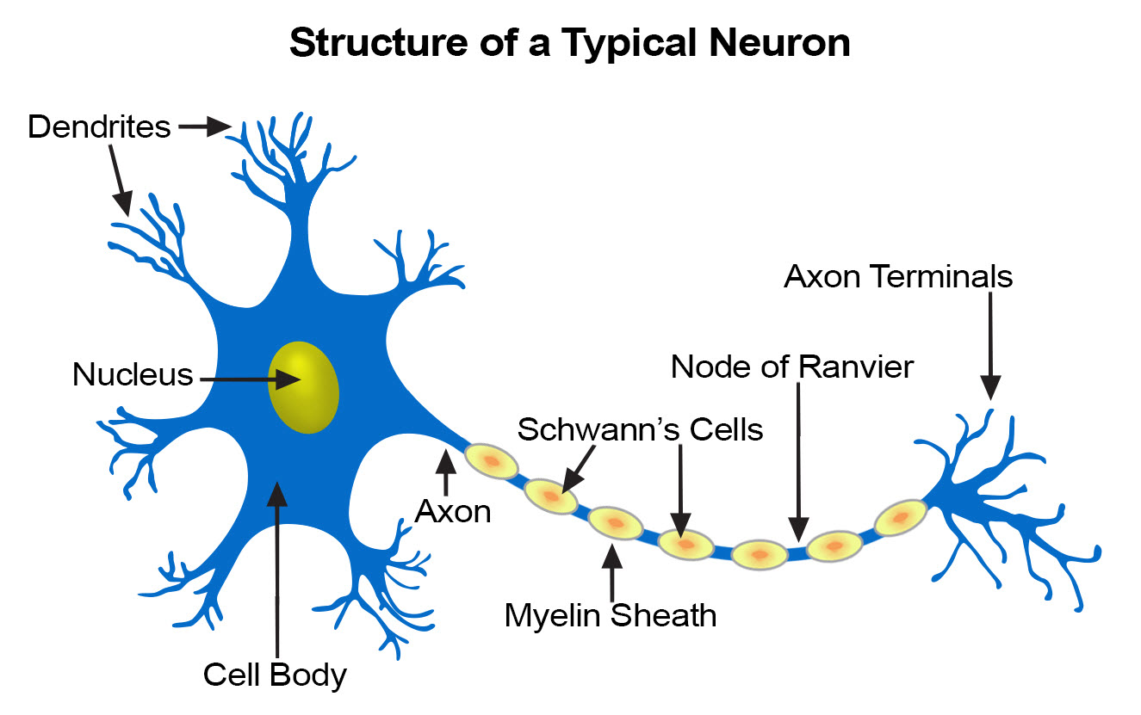
PERCEPTRON
Perceptrons are the simplest example of a neural network
The idea is to emulate a single neuron

Slide 10
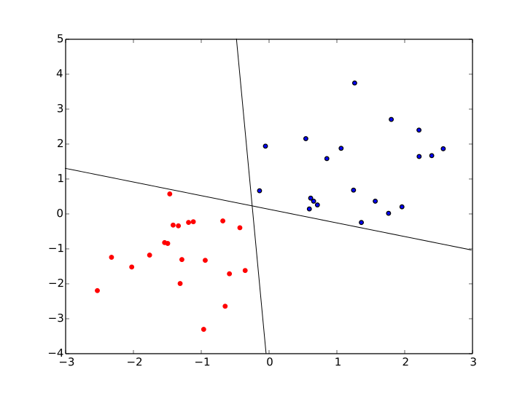
PERCEPTRON
Perceptrons are the simplest example of a neural network
Given n inputs and an activation or link function f
The perceptron computes a linear separating curve

Slide 11
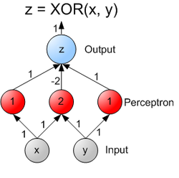
PERCEPTRON
Common activation functions are linear, logistic, tanh, and softmax
We’ll see shortly that some are better for classification, some for regression
Perceptrons can be combined into multilayer perceptrons or feed-forward network

Slide 12

FEED FORWARD NN
Source

Slide 13

FEED FORWARD NN
Source

Slide 14
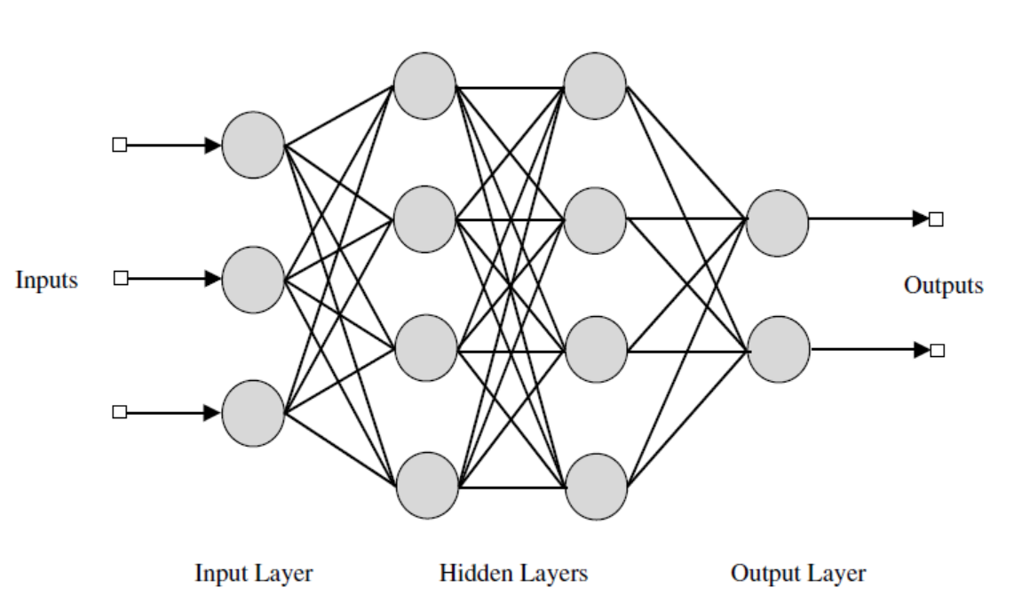
FEED FORWARD NN
Source

Slide 15
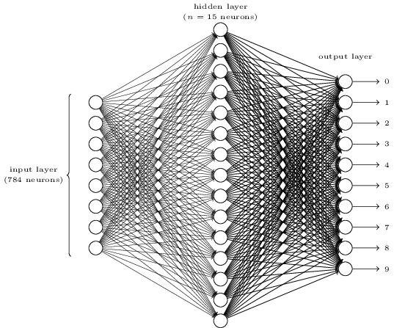
FEED FORWARD NN
Source

Slide 16
FEED FORWARD NN
Typically we use
Tanh or logistic layers for input
Linear layers for regression output
Logistic or Tanh for binary output
Softmax for n-class output (yields probabilities)

Slide 17
GUIDED PRACTICE
TRAINING

Slide 18
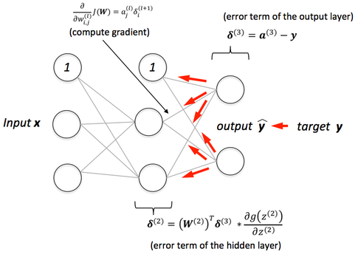
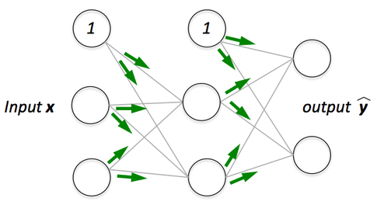
TRAINING
Feed forward neural networks can be trained with backpropagation
Source

Slide 19
TRAINING
Key Parameters
Learning Rate (gradient descent for training)
Epochs: number of backpropagation passes (over entire dataset)
Batch size: how many training points used at a time to update weights
Model others behaves as usual with
model.predict
model.predict_classes

Slide 20
TRAINING
Tips
If the error jumps around per epoch, decrease the learning rate
Taking too long to train: use higher learning rate or batch_size
High error after convergence?
More hidden layers / neurons
Normalize data or use PCA

Slide 21
INTRODUCTION
UNIVERSAL APPROXIMATION THEORY

Slide 22
UNIVERSAL APPROXIMATION
One major reason that neural networks are useful is the Universal Approximation Theorem
The result basically says that many real vector-valued functions can be approximated arbitrarily well with some feed-forward neural network
This is why neural networks are useful for regression -- given enough data and the right network structure they can fit many common data sets

Slide 23
CLASSIFICATION
CLASSIFICATION WITH NEURAL NETWORKS

Slide 24
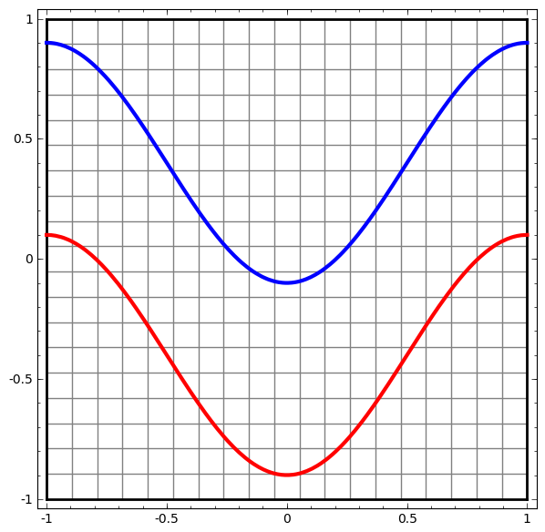
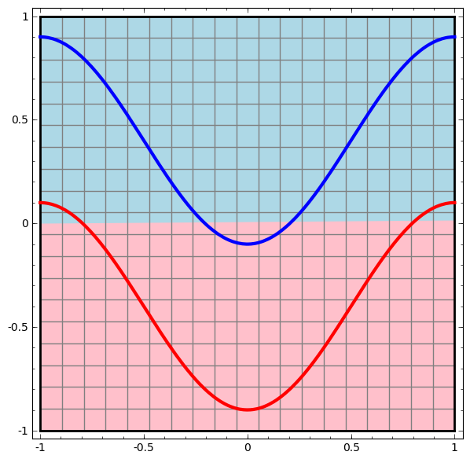
CLASSIFICATION
Neural Networks are also extremely useful for classification (source)
No hidden layers:

Slide 25
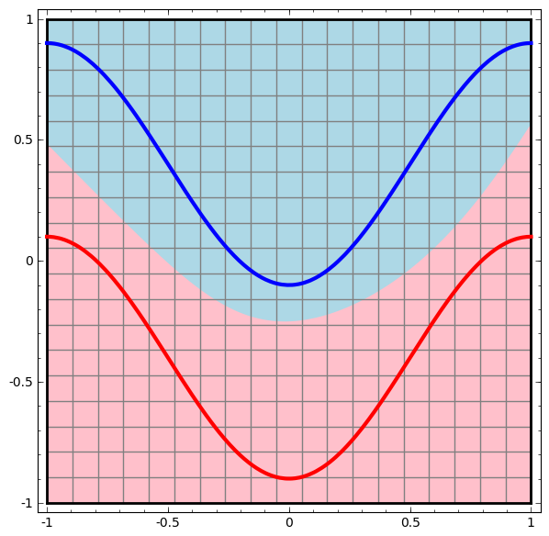
CLASSIFICATION
Neural Networks are also extremely useful for classification (source)
One hidden layer:

Slide 26
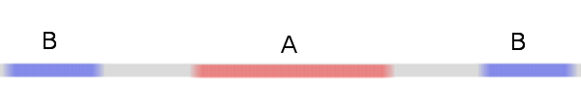
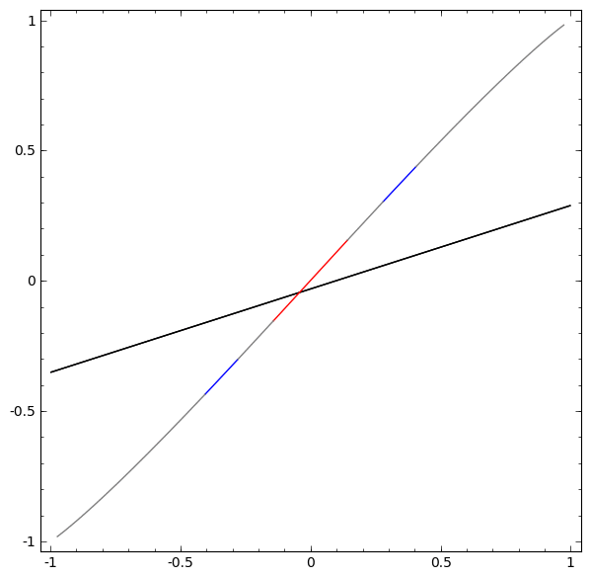
CLASSIFICATION
Neural Networks are also extremely useful for classification (source)

Slide 27
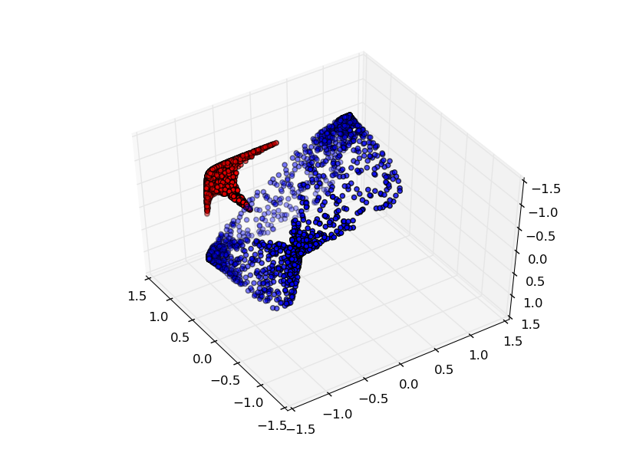
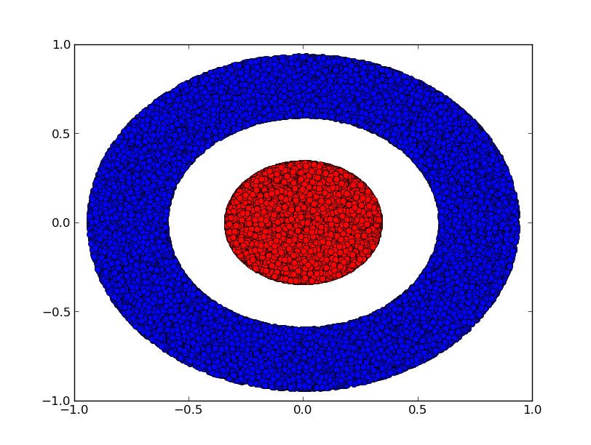
CLASSIFICATION
Neural Networks are also extremely useful for classification (source)

Slide 28
CLASSIFICATION
The neural network transforms the data topologically (no tears or breaks) and then separates the data with a hyperplane
NNs are capable of handling difficult data sets, including:
Image processing: recognizing hand-written characters
Image compression
Financial forecasting
Many others

Slide 29

ACTIVITY: KNOWLEDGE CHECK
Let’s practice using neural networks for classification. For each of the four datasets, experiment with the number of layers and neurons to find the best model
Also take a look at this visualization
ANSWER THE FOLLOWING QUESTIONS
EXERCISE
DELIVERABLE
Answers to the above questions

Slide 30
GUIDED PRACTICE
NEURAL NETWORKS IN PYTHON

Slide 31
NN IN PYTHON
There are many NN libraries for python and other languages
Python
Theano
Keras
Lasagne
TensorFlow
Scikit Learn support for NN coming in 0.18
Lua
Torch
Some of these libraries utilize GPUs for (much) faster training

Slide 32
NN IN PYTHON
Let’s look at some examples in Keras
Regression
Classification

Slide 33
GUIDED PRACTICE
DESIGNING NEURAL NETWORKS

Slide 34
NN IN PYTHON
Network design is a hard problem
Experience helps
Evolutionary algorithms are useful for design
Nice (free) book available

Slide 35
RECCURENT NN
RECURRENT NEURAL NETWORKS

Slide 36
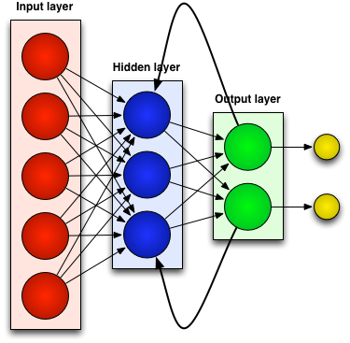
RECURRENT NEURAL NETWORKS
Recurrent Neural Networks contain loops (source)

Slide 37
RECURRENT NEURAL NETWORKS
Recurrent Neural Networks contain loops
This implements feedback and gives neural networks “memory” or context
Particularly good for predicting sequences, translating text, recognizing objects in images, speech translation
Commonly referred to as deep learning, involving both feature extraction and modeling
Nice intro here

Slide 38
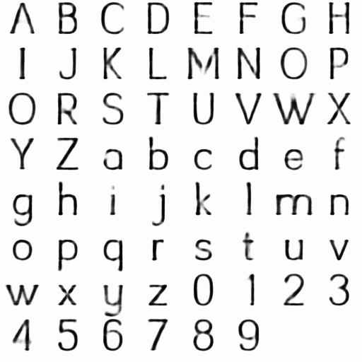
RECURRENT NEURAL NETWORKS
RNN font analysis

Slide 39
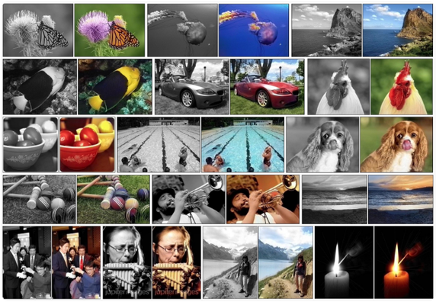
RECURRENT NEURAL NETWORKS
Automatic Colorization with CNN

Slide 40
RECURRENT NEURAL NETWORKS
RNN font analysis
Automatic Colorization with CNN
Automatic translation
Deep Learning Applications

Slide 41
CONCLUSION
TOPIC REVIEW

Slide 42
CONCLUSION: Neural Networks
Pros:
Flexible
Good for a variety of tasks
Good for many types of data
Cons:
Can require a lot of data
Training may be slow
Many parameters to tune
Many layer types and activations
Black Box model

Slide 43
CONCLUSION
Many more examples for Keras available
Recommended articles: Convolutional NN,
Advanced machine learning methods you should explore include Bayesian methods and deep learning

Slide 44
COURSE
BEFORE NEXT CLASS

Slide 45
DUE DATE
BEFORE NEXT CLASS
Project: Final Project, Part 5!!

Slide 46
LESSON
EXIT TICKET
DON’T FORGET TO FILL OUT YOUR EXIT TICKET

